Slide 1

Moving from Relational database to Document database architecture

Slide 2
Contents
Relational Database and Document-Oriented Database
Conventional table with document-based objects
Migrating your data to Document Database
Document Database – JSON documents are not limited to fields
High Level Diagram – Document DB
Performing Migration

Slide 3
Relational Database and Document-Oriented Database
Comparing Relational DB and Document Oriented DB
In a relational database system you must define a schema before adding records to a database.
The schema is the structure described in a formal language supported by the database and provides a blueprint for the tables in a database and the relationships between tables of data.
Within a table, you need to define constraints in terms of rows and named columns as well as the type of data that can be stored in each column.
In contrast, a document-oriented database contains documents , which are records that describe the data in the document, as well as the actual data In a document-oriented model, data objects are stored as documents; each document stores your data and enables you to update the data or delete it.

Slide 4
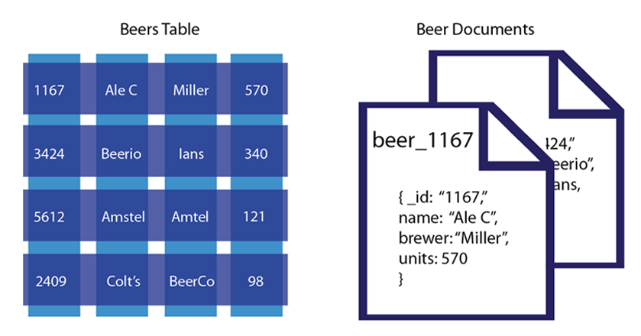
Relational Database and Document-Oriented Database
Conventional table with document-based objects

Slide 5
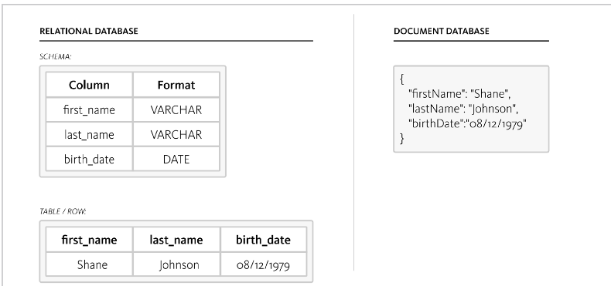
Document Database - Migrating your data
In Document database - data is stored in JSON documents not in tables.
JSON documents are self-describing. As such, every JSON document includes its own flexible
schema, and it can be changed on demand by changing the document itself

Slide 6
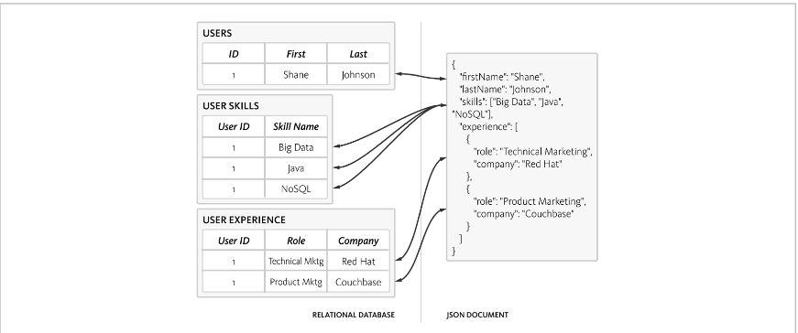
Document Database – JSON documents are not limited to fields
JSON documents are not limited to fields. They can include arrays and objects, and they can be nested.

Slide 7
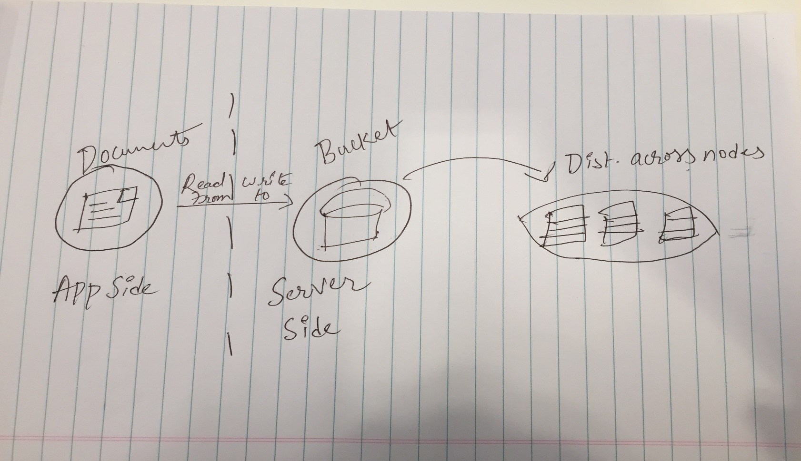
High Level Diagram

Slide 8
Performing Migration
The easiest and fastest way to get started is to export your relational data to CSV
files, and import them into Document-Oriented Server (MongoDB, NoSQL). This may not represent the final data model, but it will enable you to start interacting with Document-Oriented Server right
away. Document-Oriented Server includes a command line utility, transfer, for importing
data in CSV files. By default, it assumes the first row is the field names and
one of them is “id”.
$ dotransfer /<path to file>/<filename>.csv http://<cluster ip>:8091 -B
<bucket name> -u Administrator -p password

Slide 9
Thank You

